Slide 1
COVID-19 HOME CARE KIT
GROUP ID: 777
GROUP MEMBERS:
Akshay Shinde (B00813062)
Charuhas Daware (B00815646)
Parneet Lnu (B00816285)

Slide 2

MOTIVATION
WHY?
COVID-19 is still spreading across the world and monitoring it in remote areas is still a tedious task
HOW?
Take remote health measurements and monitor them from anywhere at anytime

Slide 3

BACKGROUND
This is a new technique intended to collect health stats, such as body temperature,
heart rate and oxygen level of every individual who posses the kit and make it available to the medical advisor or health centers remotely so as to examine a COVID suspected patient
With this medical device - incorporated with remote sharing technology, no individual will have to leave their houses for health checkup.

Slide 4
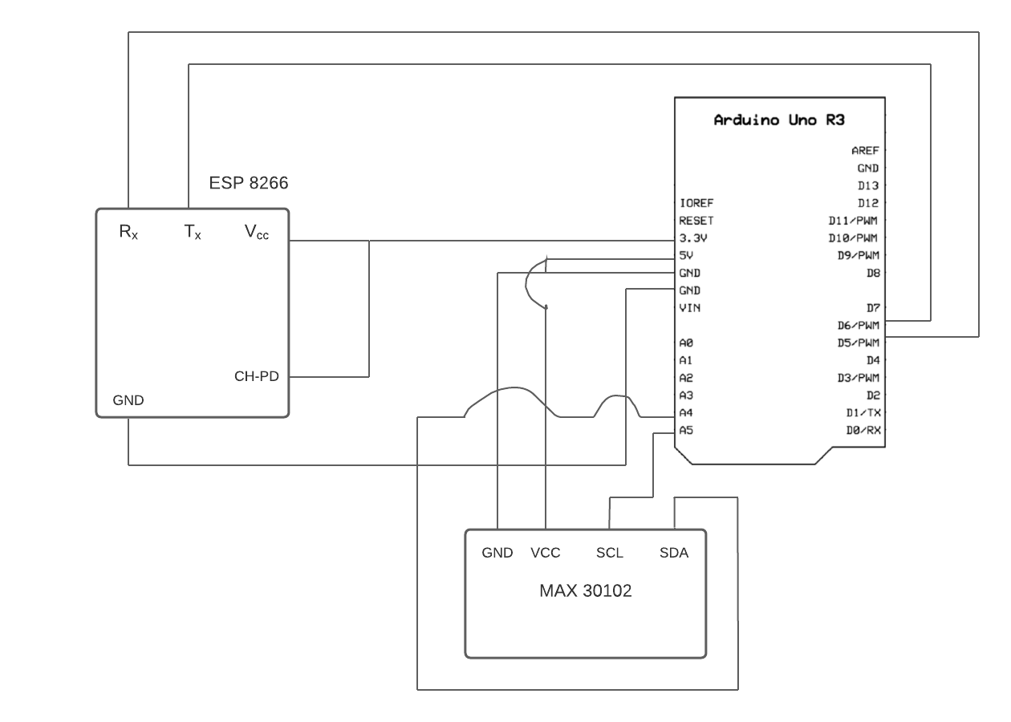
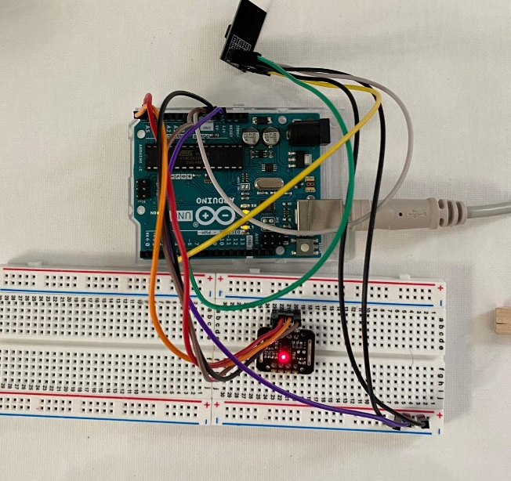
Hardware Specifications
Arduino microcontroller (Arduino Uno R3)
Breadboard
Heartbeat sensor module (MAX 30102)
Blood Oxygen sensor module (MAX 30102)
Temperature Sensor (MAX 30102)
WiFi module (ESP8266)

Slide 5
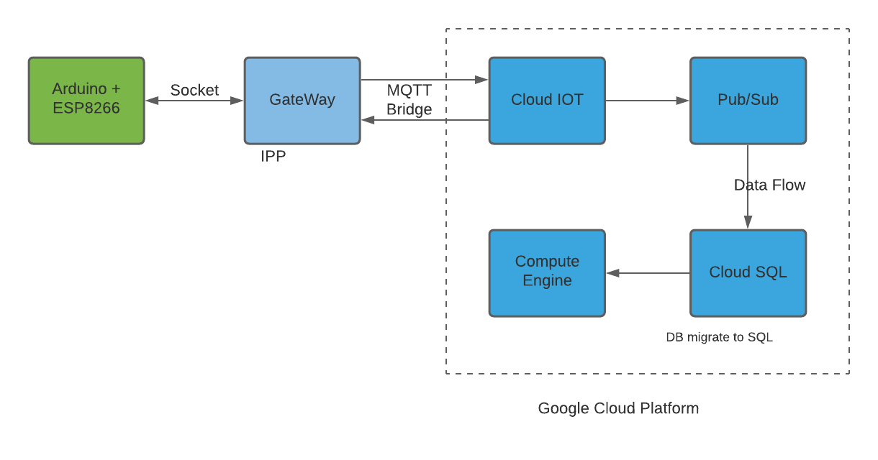
Project Architecture

Slide 6

Cloud Technologies Used
Compute Engine – It is an Infrastructure as a service component using which we hosted our website.
CloudSQL -It is fully managed database service that helps to maintain setup and administer MySQL database. We used this service of GCP to maintain database for our website.

Slide 7
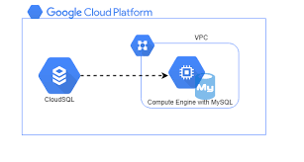
Cloud Technologies Used
Cloud IoT Core – It is fully managed service that helps to connect, manage and ingest data from IoT devices.

Slide 8

Demo

Slide 9
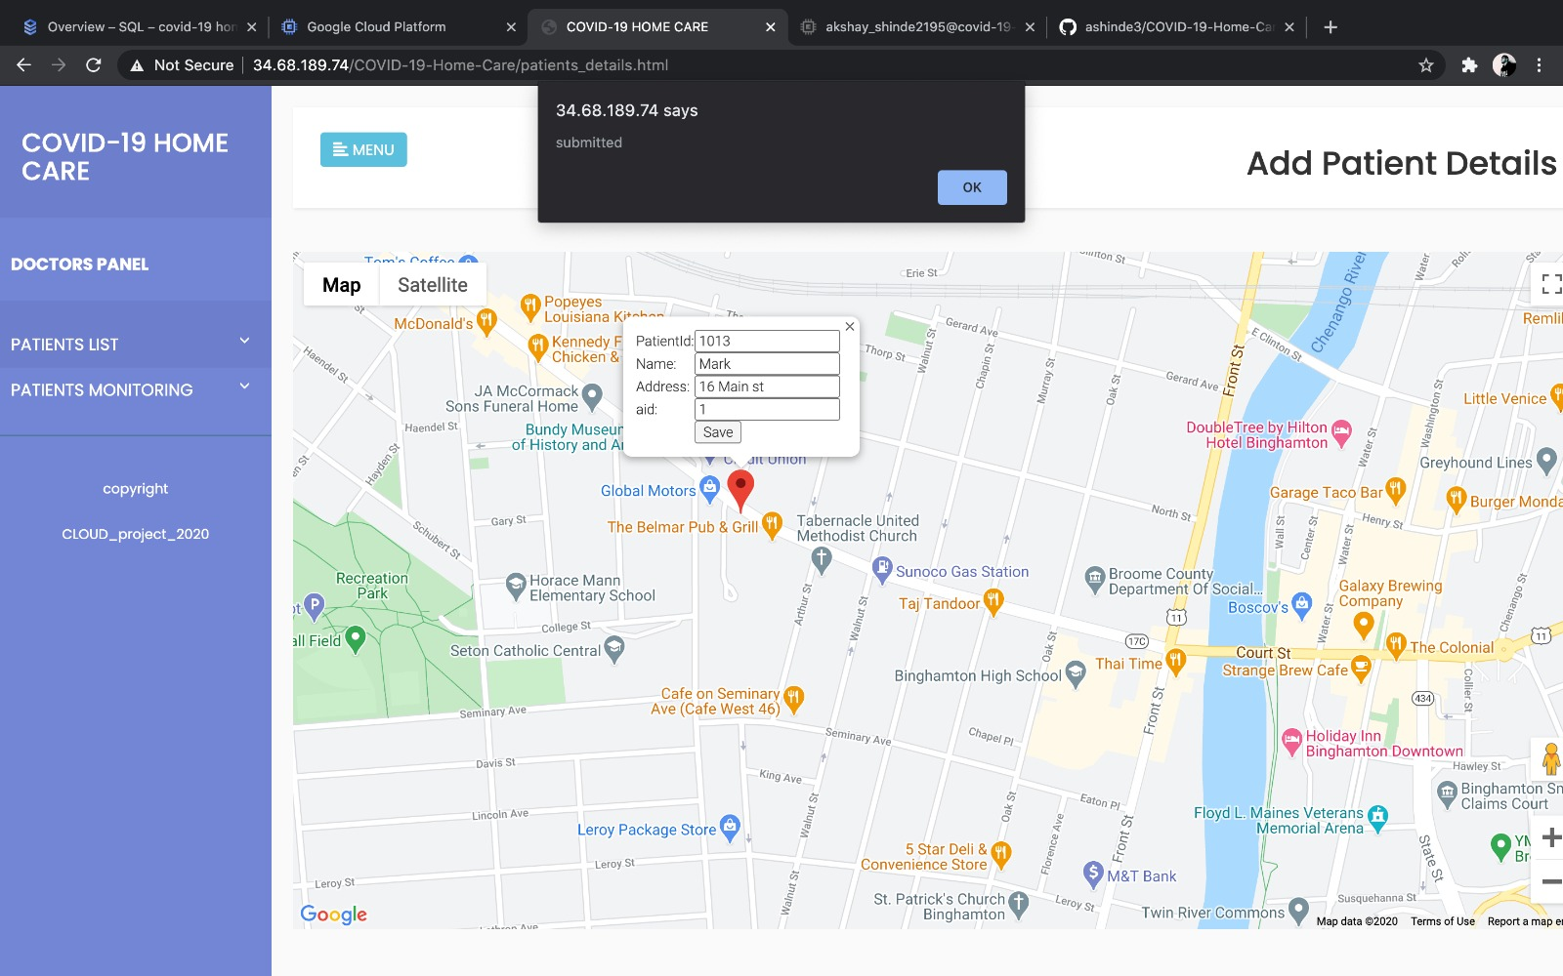

Slide 10
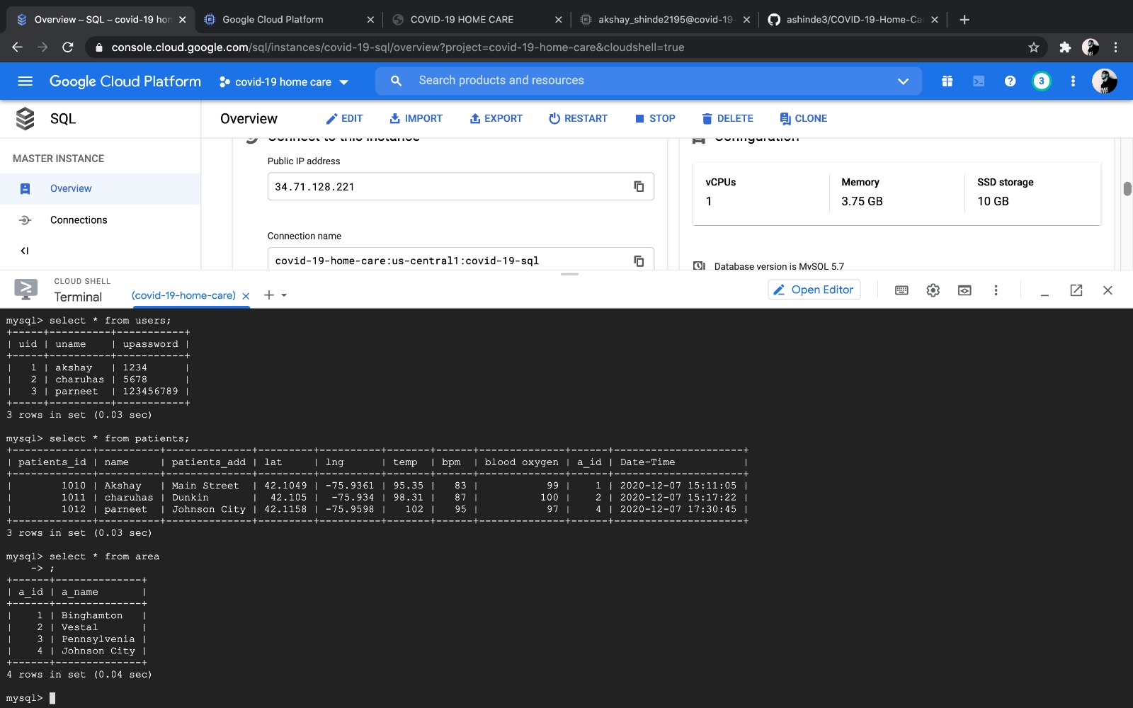

Slide 11
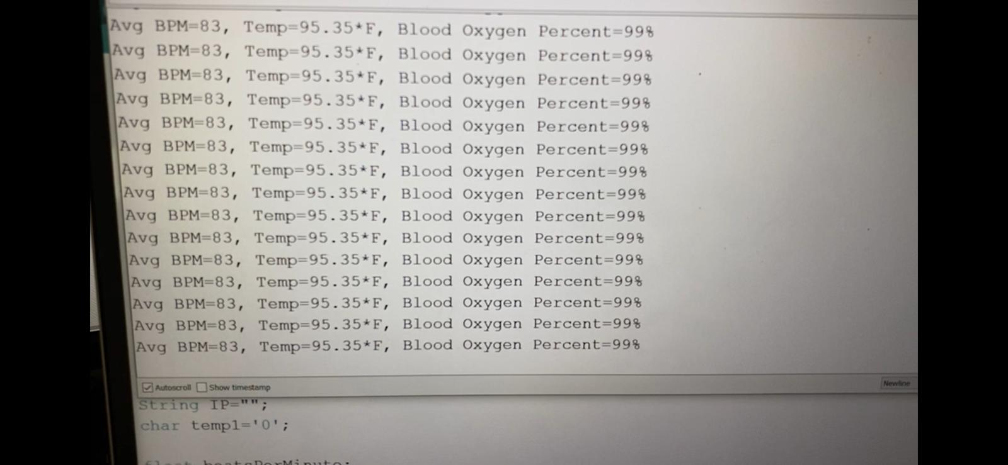

Slide 12
Conclusion and Future Scope
This technology is another step towards remote medical services which is beneficial to the young, old, and the far located. It will help track the COVID patients around the globe leading to monitoring and controlling the spread of this pandemic.
Future Scope:
Increase the count and quality of sensors.
Make another portal for patients to login and track their data.
Currently one device can record and update data for a single patient. This can be improved such that a single family can use a kit.

Slide 13





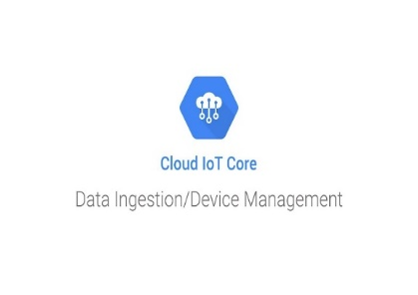





Technologies Used

Slide 14

Thank you!!

